Slide 1
CSE 2217
Data Structure and Algorithms II
Minimum Spanning Tree (Kruskal’s)
Tahmid Mosaddeque
Lecturer
Department of CSE, UIU

Slide 2
Problem: Laying Telephone Wire
Central office

Slide 3
Wiring: Naïve Approach
Central office
Expensive!

Slide 4
Wiring: Better Approach
Central office
Minimize the total length of wire connecting the customers

Slide 5
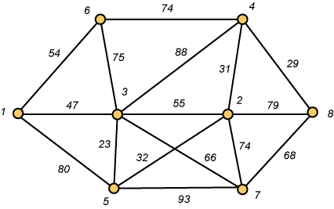
A Networking Problem
Problem: The vertices represent 8 regional data centers which need to be connected with high-speed data lines. Feasibility studies show that the links illustrated above are possible, and the cost in millions of dollars is shown next to the link. Which links should be constructed to enable full communication (with relays allowed) and keep the total cost minimal.

Slide 6
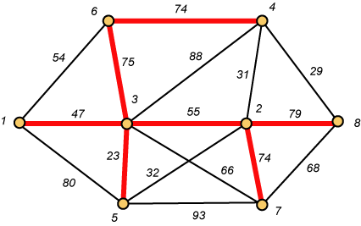
Links Will Form a Spanning Tree
Cost (T) = 47 + 23 + 75 + 74 + 55 + 74 + 79
= 427

Slide 7
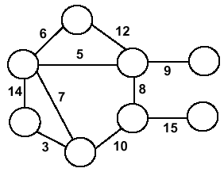
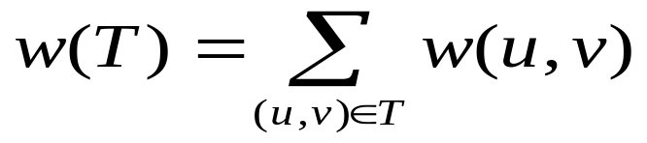
Minimum Spanning Trees
Undirected, connected graph G = (V,E)
Weight function W: E → R (assigning cost or length or other values to edges)
Spanning tree: tree that connects all the vertices (above?)
Minimum spanning tree: tree that connects all the vertices and minimizes

Slide 8
Minimum Spanning Tree (MST)
A minimum spanning tree is a subgraph of an undirected weighted graph G, such that
it is a tree (i.e., it is acyclic)
it covers all the vertices V
  contains |V| - 1 edges
the total cost associated with tree edges is the minimum among all possible spanning trees
not necessarily unique

Slide 9
How Can We Generate a MST?
9
b
9
b
a
2
6
a
2
6
d
d
4
5
4
5
5
4
5
4
5
e
5
e
c
c

Slide 10
Greedy Choice
We will show two ways to build a minimum spanning tree.
A MST can be grown from the current spanning tree by adding the nearest vertex and the edge connecting the nearest vertex to the MST. (Prim's algorithm)
A MST can be grown from a forest of spanning trees by adding the smallest edge connecting two spanning trees. (Kruskal's algorithm)

Slide 11
Kruskal's Algorithm
Edge based algorithm
Add the edges one at a time, in increasing weight order
The algorithm maintains A – a forest of trees. An edge is accepted it if connects vertices of distinct trees
We need a data structure that maintains a partition, i.e.,a collection of disjoint sets
  MakeSet(S,x)
  Union(S_{i},S_{j})
  FindSet(S, x)

Slide 12
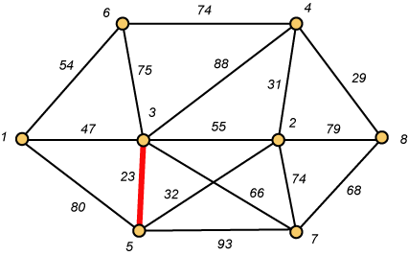
Kruskal – Step 1

Slide 13
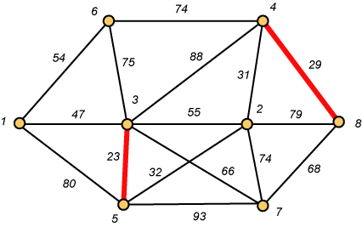
Kruskal – Step 2

Slide 14
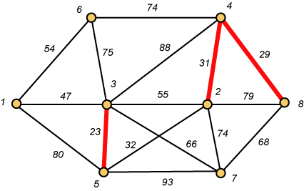
Kruskal – Step 3

Slide 15
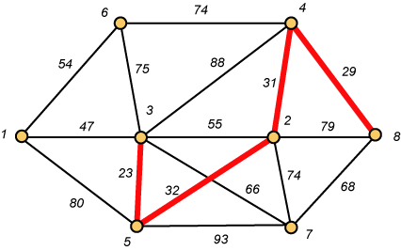
Kruskal – Step 4

Slide 16
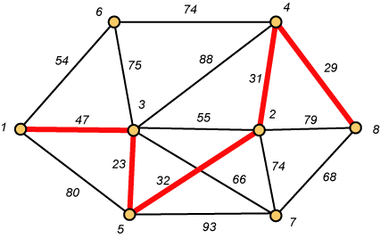
Kruskal – Step 5

Slide 17
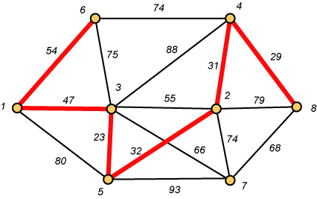
Kruskal – Step 6

Slide 18
Why Avoiding Cycles Matters
Up to this point, we have simply taken the edges in order of their weight. But now we will have to reject an edge since it forms a cycle when added to those already chosen.

Slide 19
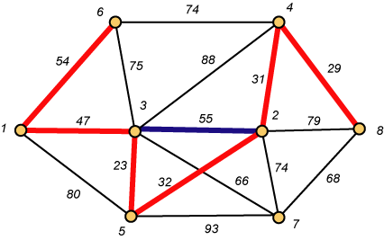
Forms a Cycle
So we cannot take the blue edge having weight 55.

Slide 20
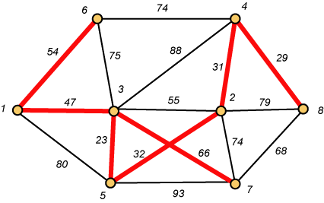
Kruskal – Step 7 DONE!!
Weight (T) = 23 + 29 + 31 + 32 + 47 + 54 + 66 = 282

Slide 21
Disjoint-Set
Keep a collection of sets S₁, S₂, .., S_{k},
  Each S_{i} is a set, e,g, S₁={v₁, v₂, v₈}.
Three operations
  Make-Set(x)-creates a new set whose only member is x.
  Union(x, y) –unites the sets that contain x and y, say, S_{x} and S_{y}, into a new set that is the union of the two sets.
  Find-Set(x)-returns a pointer to the representative of the set containing x.

Slide 22
Kruskal's Algorithm
The algorithm adds the cheapest edge that connects two trees of the forest
MST-Kruskal(G,w)
01 A ← ∅
02 for each vertex v ∈ V[G] do
03 Make-Set(v)
04 sort the edges of E by non-decreasing weight w
05 for each edge (u,v) ∈ E, in order by non-decreasing weight do
06 if Find-Set(u) ≠ Find-Set(v) then
07 A ← A ∪ {(u,v)}
08 Union(u,v)
09 return A
O(V)
O(ElogE)
O(E)
O(V)
Overall Complexity: O(VE)

Slide 23
Question
Exercise
  23.2.7 – Add new vertices & edges in a graph
  23-1: Second best minimum spanning tree

Slide 24
CLRS Chapter 23
Growing a minimum spanning tree
Definitions
  Cut
  Safe Edges
  Light Edges
Operations
  Crossing
  Respecting

Slide 25
Theorem 23.1
Let G =(V, E) be a connected, undirected graph with a real valued weight function W defined on E. Let A be a subset of E that is included in some minimum spanning tree for G, let (S, V -_x0005_ S) be any cut of G that respects A, and let (u, v) be a light edge crossing (S, V -_x0005_ S). Then, edge (u, v) is safe for A.

